Slide 1
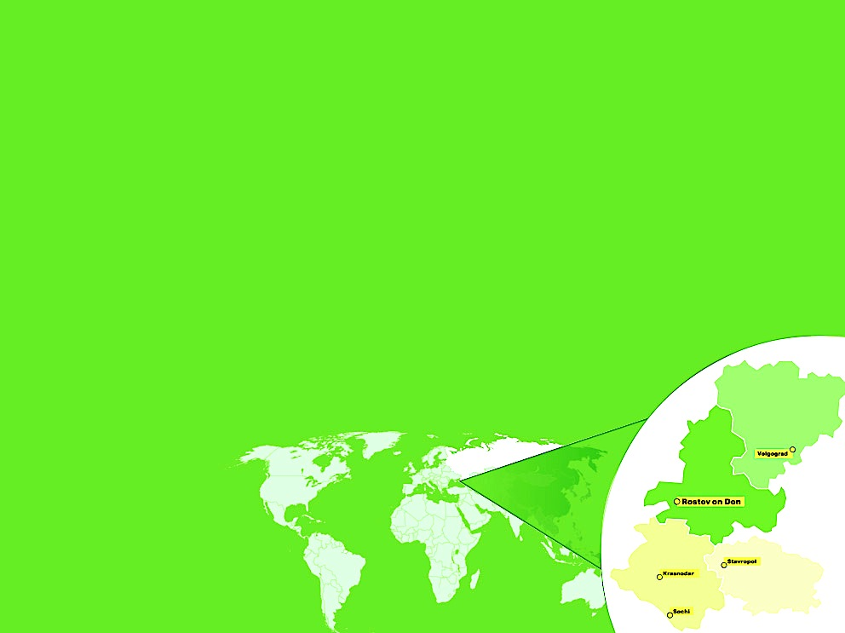

Distance Economy Design Concept
Dr. Prof. Vasily Vysokov,
Rostov State University of Economics,
Chairman of the Board of Directors of
Center-invest Bank
Rostov-on-Don
Russia
8 May 2020
Notes:
1. Center-invest Bank was established in 1992 by the first privatized enterprises and professors of the Rostov State University of Economics. 30 years the bank has been working as a laboratory of reforms in the South of Russia.
Our shareholders (EBRD, DEG, Erste group, responsAbility Participations AG, Rekha Holdings LTD, Firebird Funds, Raiffeisenlandesbank Oö), our partners (IFC, BSTDB, OöEB) describe the Bank's ESG business model very precisely: "CENTER-INVEST WAS, IS AND WILL BE THE BEST!»

Slide 2

ToR
- Transition economy: from A to B
- Transformation economy: non-stop challenges
in non-stop crises
An economic mechanism (EM)
is a set of rules that
governs economic relations
Design
Rules
Models
Data
2
Notes:
2. Our team (the Bank and the University) started working in a stable, planned economy, we have gained experience in the transition economy and are now successfully working in a transformational economy: of non-stop challenges in non-stop crises.
We have actively worked with data analysis and economic models. Thanks to reforms, we have experience in the art of designing economic rules (design of economic mechanisms).

Slide 3
Interrelation of Subsystems of the economic mechanism
3
Notes:
3. The Economic mechanism (rules) can be grouped into different subsystems. The latest GRI recommendations are to identify: Institutions, Markets, and rules that ensure reproduction of the Financial, Investment, Industrial, Intellectual, Human, Social, Informational, and Natural capital. At the macro level, subsystem extensions are required: Institutions, Markets, and Pricing Mechanisms. A design project is created by a table of interrelationship table based on the principles of SWOT analysis.

Slide 4
Distance Economy Design Concept
4
Notes:
4. The design project of the Distance Economy is based on a self-employed individual, the interaction of self-employed individuals on the marketplaces, the civil code replaces the labor code, robots and artificial intelligence work at large enterprises, the budget works not as a swimming pool, but as a closed cycle of cash flow, co-financing of investments is carried out through platforms, ecosystems of self-employed individuals are formed, the role of information and individual capital increases, different price models are used, attention to the environment increases. Since each of the proposed mechanisms has not only strengths and opportunities, the impact of weaknesses and threats is compensated by mechanisms in related subsystems. We have created a sustainable design project for the Distance Economy.

Slide 5
Transformational business to Distance Economy
5
Notes:
5. Based on the design project of the Distance Economy, an interactive questionnaire "Business Transformation in the Distance Economy " was developed and conducted among businessmen of the region. Despite the May holidays in Russia, we have already received more than 400 responses that allow us to draw conclusions.

Slide 6
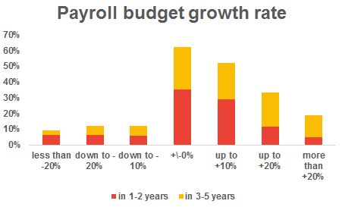
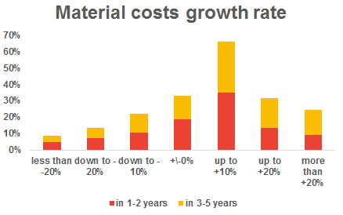
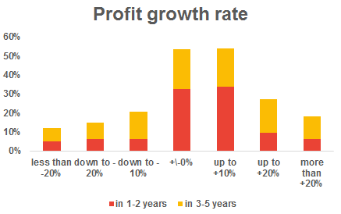
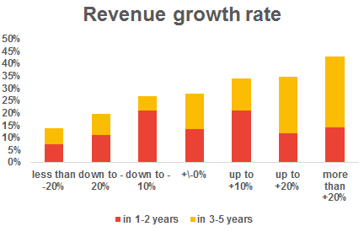
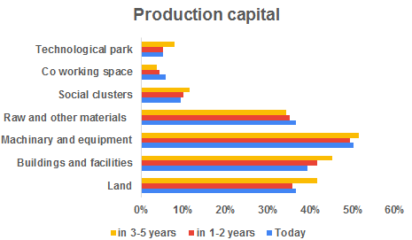
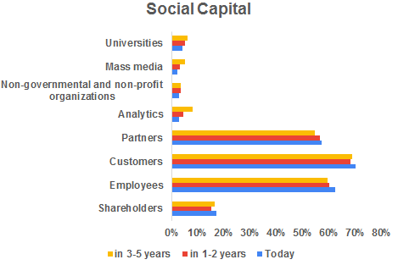
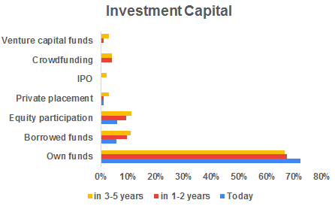
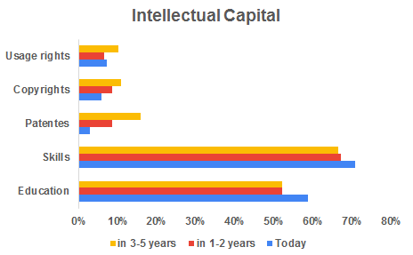
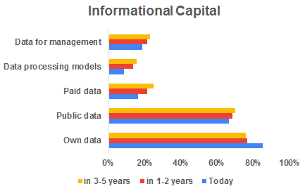
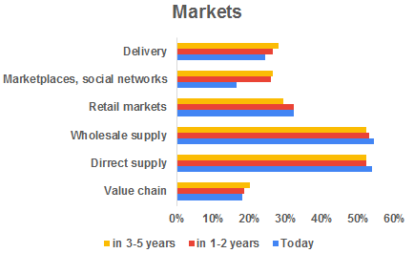
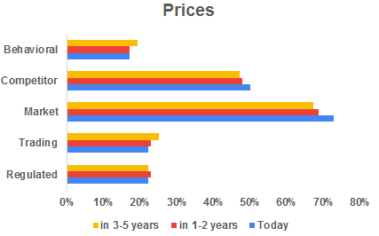
Transformational business to Distance Economy
6
Notes:
6. After COVID19, the business of the Southern Russia will be develop by V-shaped recovery, with low profit, costs and salary, based on its own sources of financing, the use of new machines and equipment, its own and open data, education and skills of employees, a high level of social responsibility towards staff, customers and partners in the presence of transparent markets and competitive prices

Slide 7
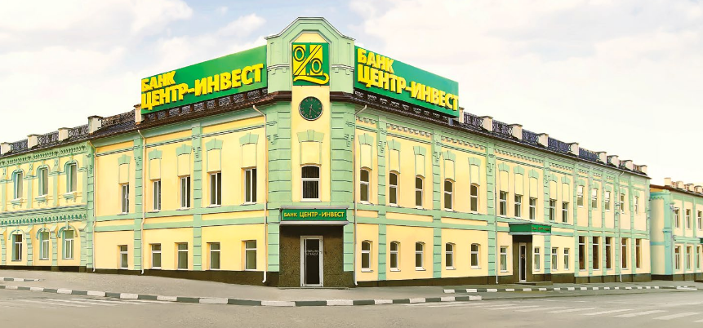

Contacts
344 000, 62 Sokolova avenue
Rostov-on-Don, Russia
centrinvest.ru welcome@centrinvest.ru
7

